Slide 1

To study the Impacts of having side income sources on one’s personal and professional life
Shruti Ushire 906
Mitali Kubal 901
1

Slide 2
Table of Contents:-
Abstract
Introduction
Objective of the study
Methodology
Data Collection & Preparation
Data description
Data Analysis
Data Visualization
Statistical techniques used for analysis
Reference links
Conclusion
2

Slide 3
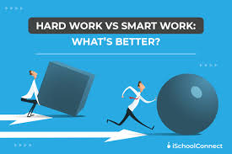



Abstract:
I. This research project explores the impact of having side income sources on an individual's personal and professional life in today's dynamic and competitive world
II. The study aims to comprehensively understand the motivations, benefits, challenges, and risks associated with pursuing side income opportunities alongside full-time jobs
III. The objectives include examining the factors influencing individuals' decisions to pursue side income, assessing the impact on financial well-being, analyzing work-life balance effects, investigating career development opportunities, and identifying required skills and competencies
IV. By contributing to the existing literature on work-life balance, career development, and personal finance, this project provides valuable insights for individuals and organizations navigating the changing landscape of work and income generation.
3

Slide 4
Introduction
In today's competitive world, many individuals pursue side income sources alongside their regular jobs or studies
Side income refers to part-time jobs or businesses that provide extra income and opportunities for skill development.
This trend offers numerous benefits such as financial improvement, skill enhancement, passion pursuit, and networking
This research explores the motivations, impacts, and challenges of side income sources, providing valuable insights for individuals and organizations navigating the changing landscape of work and income generation.
4

Slide 5





Objective of the study
To examine the motivations behind individuals pursuing side hustles and understand the impact of these additional income sources on their personal and professional lives.
To identify the various types of side hustles individuals engage in and determine the amount of time and income dedicated to these activities.
To explore the behaviors and time allocation patterns of both side hustlers and non-side hustlers outside of their primary work or studies.
To investigate the factors that can influence an individual's earnings from side hustles, considering aspects beyond their full-time job.
To assess if there are significant differences in mental health, work-life balance, and time management between individuals with side income sources and those without.
5

Slide 6









Methodology
Doing literature and discussions :
Deciding objectives, targeted audience
& prepared questionnaire for data
collection.
Connected with participants & shared
the questionnaire (Google form)
through online mode by messaging &
putting status.
Data stored & then data is prepared for
the analysis using google sheets.
Data is analyzed using visualization
& statistical techniques.
The objectives are fulfilled. All the
findings & insights were recorded in the
form of report. Finally, the project is
successfully completed within time.
6

Slide 7
Data Collection & Preparation
Method for data collection:
Questionnaire preparation: by reading various articles & research papers, and doing discussions with individuals who pursue a side hustle.
II. Survey by circulating a questionnaire using social media like WhatsApp, Instagram, and
Facebook.
III. Convenience sampling: Participants were selected through a convenience sampling method, which involves selecting individuals who are easily accessible and willing to participate.
7

Slide 8
Data description
• There were 57 features & 410 records.
• The variables were divided into 3 main categories:
I. Demographic category: Age, Gender, Martial
Status, Education Qualification, work/study
domain, Occupation, Income,
II. Lifestyle-based category:
How do you spend your time other than
studying/working?
Do you have any loans?
Q.]Rate yourself: According to study performance &
time management (for students)
Q.]According to job satisfaction, productivity, mental
health, work-life balance, & time management (for
Full-time job/ self-employed)
Q.]Do you have any side hustle?
8

Slide 9
Data Analysis
• Techniques used:
I. Data Visualization using the dashboard
II. Statistical techniques to validate things
9

Slide 10
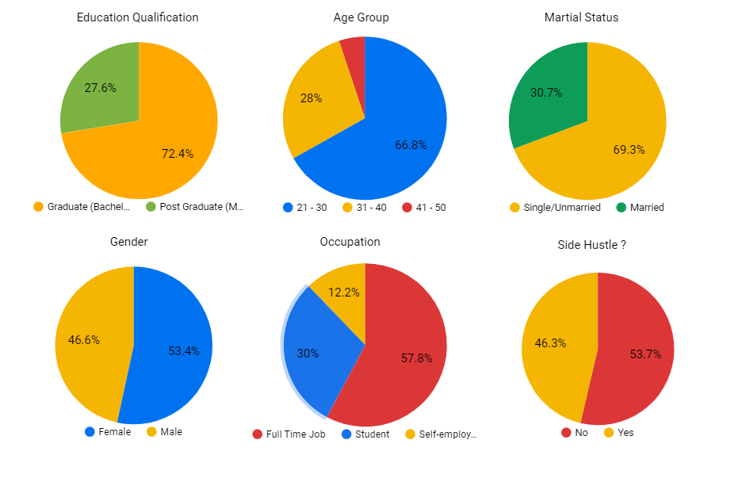
Data Visualization
To understand more about the data
10

Slide 11
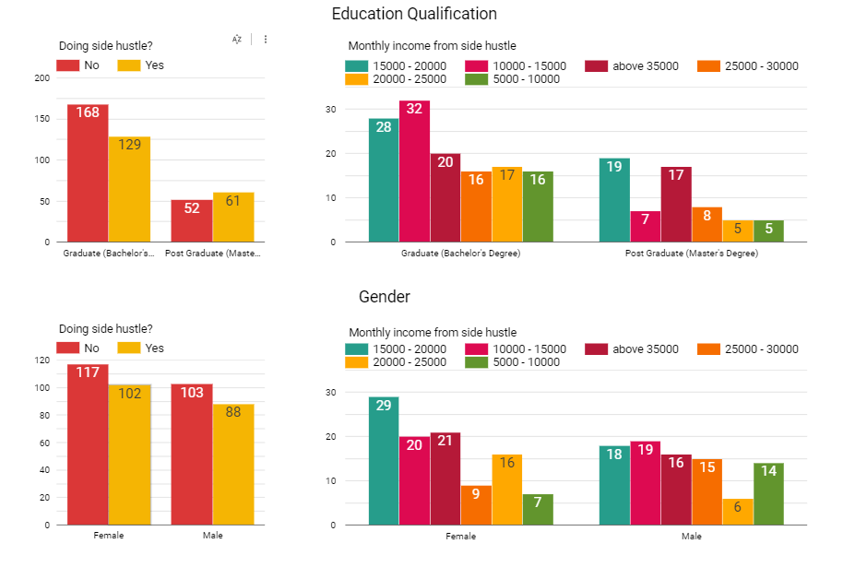
Data Visualization
out of 113 postgraduates, 54% (61) are doing side hustle
out of 297 graduates, only 43.4%(129) are doing.
Female tends to earn more money & do side hustles than Males
11
Notes:
By looking at the graph we can observe that post-graduates are more prone to do side hustles compared to graduates.

Slide 12
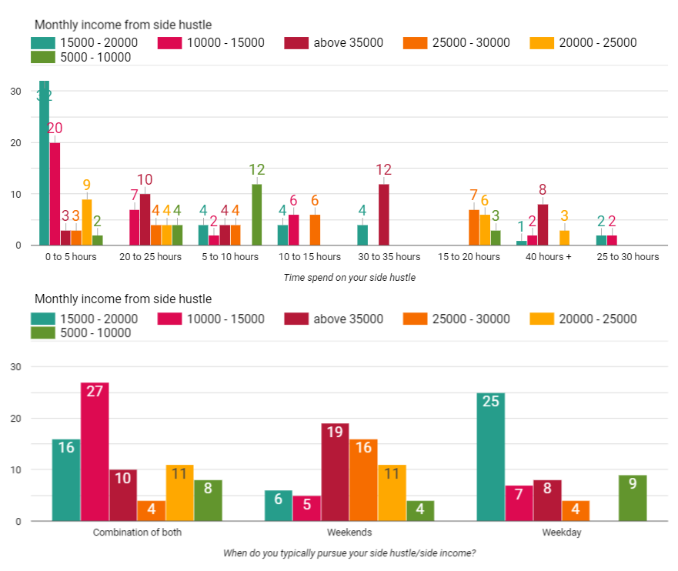
time spend & on which days an individual earns more money using side
hustle:
Most of the individuals fond to do their side hustle
either on a combination of both or weekends.
Individuals who do side hustles on weekends tend to
earn more money above 25k +
Most individuals invest less than or equal to
5 hours for thein side income source.
12

Slide 13
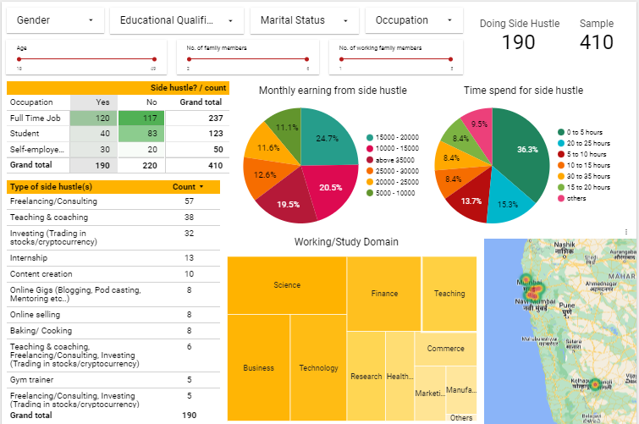
Behavior of Side Hustlers:
13

Slide 14
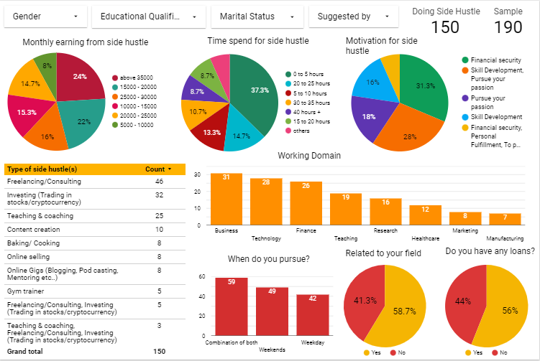
Behavior of Side Hustlers who does full time job/self employed:
14

Slide 15
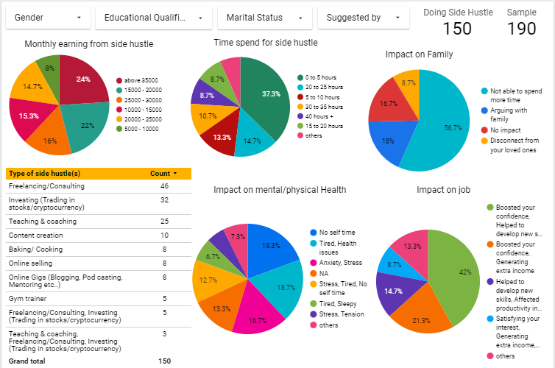
Impact of Side Hustlers who does full time job/self employed:
15

Slide 16
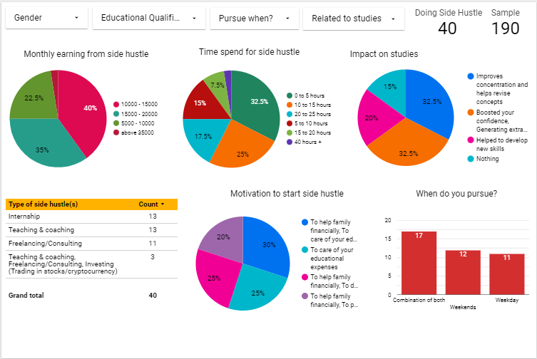
Behavior & Impact of Side Hustlers who are Students:
16

Slide 17
Statistical techniques used for analysis
One Way ANOVA
Wilcoxon signed-rank test
17

Slide 18
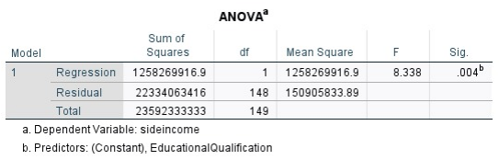
One Way ANOVA
To determine if there is a significant difference among different educational levels(Graduate,Post-Graduate) in terms of side income.
The hypotheses for this test are as follows:
Null Hypothesis (H0): There is no significant difference in the mean side income among different educational levels.
Alternative Hypothesis (H1): There is a significant difference in the mean side income among different educational levels.
By looking at the table above (p value is < 0.05) we can reject H0 and conclude that there is
significant difference in the mean side income among different educational levels.
18

Slide 19
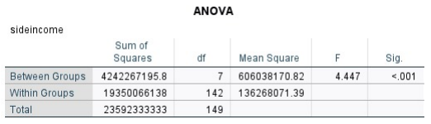
To determine if there is a significant difference among different work domain levels in
terms of side income.
The hypotheses for this test are as follows:
Null Hypothesis (H0): There is no significant difference in the mean side income among
different work domain levels.
Alternative Hypothesis (H1): There is a significant difference in the mean side income among
different work domain levels.
By looking at the table above (p value is < 0.05) we can reject H0 and conclude that there is
significant difference in the mean side income among different work domain levels.
19

Slide 20
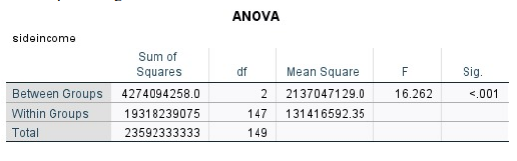
To determine if there is a significant difference among different work domain levels in terms of side income.
The hypotheses for this test are as follows:
Null Hypothesis (H0): There is no significant difference in the mean side income among different time spent categories.
Alternative Hypothesis (H1): There is a significant difference in the mean side income among different time spent categories.
By looking at the table above (p value is < 0.05) we can reject H0 and conclude that there is
significant difference in the mean side income among different time spent categories.
20

Slide 21
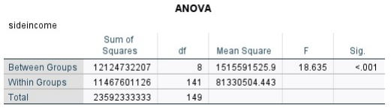
To determine if there is a significant difference among different work domain levels in terms of side income.
The hypotheses for this test are as follows:
Null Hypothesis (H0): There is no significant difference in the mean side income among different working style categories.
Alternative Hypothesis (H1): There is a significant difference in the mean side income among different working style categories.
By looking at the table above (p value is < 0.05) we can reject H0 and conclude that there is
significant difference in the mean side income among different working style categories.
21

Slide 22
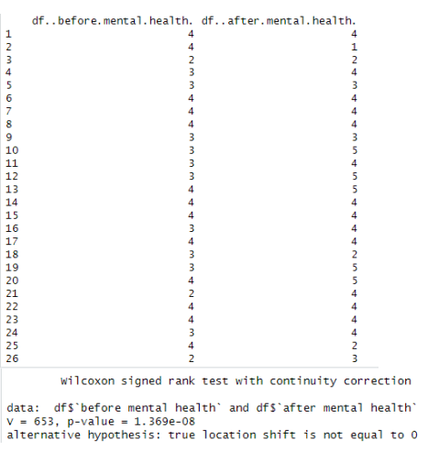
Wilcoxon signed-rank test
To study if there is any significant difference in mental health of an individual after having side hustle.
H0: There is no significant effect on mental health
of an individual after having side hustle
H1: There is significant effect on mental health
of an individual after having side hustle
p value is less than 0.05, Therefore we can reject H0
and conclude that there is a significant effect on mental
health of an individual after pursuing side hustle.
Here the test statistics we got was positive indicates that there
is positive impact on mental health.
22

Slide 23
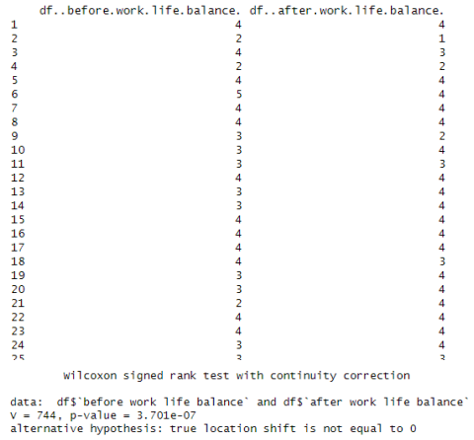
To study if there is any significant difference in work life balance of an individual after having side hustle.
H0: There is no significant effect on work life balance
of an individual after having side hustle
H1: There is significant effect on work life balance
of an individual after having side hustle
p value is less than 0.05, Therefore we can reject H0
and conclude that there is a significant effect on work
life balance of an individual after pursuing side hustle.
Here the test statistics we got was positive indicates that
there is positive impact on work life balance.
23

Slide 24
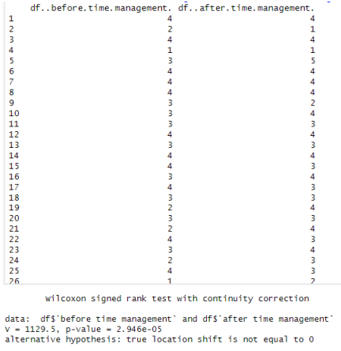
To study if there is any significant difference in time management of an individual after having side hustle.
H0: There is no significant effect on time management
of an individual after having side hustle
H1: There is significant effect on time management
of an individual after having side hustle
p value is less than 0.05, Therefore we can reject H0
and conclude that there is a significant effect on time
management of an individual after pursuing side hustle.
Here the test statistics we got was positive indicates
that there is positive impact on time management.
24

Slide 25
Conclusion
In conclusion, having a side hustle can offer numerous benefits and opportunities for
individuals in today's dynamic and competitive world. Some key points to consider are:
• Additional Income: Side hustles provide an opportunity to earn extra money outside
of a regular job. This can help individuals achieve financial goals, pay off debts, or
save for the future.
• Skill Development: Engaging in a side hustle allows individuals to acquire new skills
and knowledge. They can explore their interests, expand their expertise, and gain
valuable experience that can enhance their career prospects.
• Personal Growth and Fulfillment: Side hustles can provide a sense of personal
fulfillment and satisfaction. Individuals have the opportunity to pursue their passions,
engage in creative endeavors, and make a positive impact in their chosen field or
community.
25

Slide 26
Reference links :
https://www.shopify.com/in/blog/side-hustle
https://www2.deloitte.com/content/dam/Deloitte/in/Documents/about-deloitte/Deloitte-Millennials-GenZ-Survey-2022-INDIA.pdf
https://www.researchgate.net/publication/339585191_Do_the_Hustle_Empowerment_from_S
ide-Hustles_and_Its_Effects_on_Full-Time_Work_Performance
https://www.businessinsider.in/careers/news/bosses-listen-up-having-a-side-hustle-actually-makes-workers-feel-more-empowered-at-their-day-jobs-research-finds/articleshow/100315492.cms
https://www.wionews.com/videos/survey-gen-z-take-up-side-hustle-as-money-concerns-mount-593438
https://en.wikipedia.org/wiki/Side_job
https://www.forbes.com/advisor/business/best-side-hustle-ideas/
https://nypost.com/2023/04/06/millennials-are-most-likely-to-have-a-side-hustle-to-combat-cost-of-living/
https://www2.deloitte.com/us/en/insights/topics/talent/deloitte-millennial-survey.html
https://www.cnbc.com/make-it/side-hustles/
https://www.peoplematters.in/article/performance-management/side-hustling-is-the-new-normal-is-india-inc-ready-for-it-32894
https://nypost.com/2023/04/06/millennials-are-most-likely-to-have-a-side-hustle-to-combat-cost-of-living/
https://www.weforum.org/agenda/2022/03/india-companies-employees-side-hustle-work/
https://www.f2frecruitment.com.au/how-to-handle-moonlighting-or-a-side-
hustle/#:~:text=Whether%20you%20call%20it%20'moonlighting,taking%20on%20a%20second%20job
https://www.indiatoday.in/newsmo/video/deloitte-study-says-more-than-half-of-indian-gen-zs-and-millennials-have-a-side-job-1953153-2022-05-23
https://www.businesstoday.in/latest/story/more-than-half-of-indian-gen-zs-and-millennials-have-a-side-job-deloitte-study-334322-2022-05-19
26

Slide 27
THANK YOU !!
27

